Slide 1
HTML TAGS
MCNDHS
Ms. Eng

Slide 2
AIM: FORMS-RADIO BUTTONS
Do now:
Take out your notebooks
Open up codepen.io
Daily Grade:
On-time/attendance/not leaving the classroom: 25%
Cellphones: 25%
Notes:25%
Classwork/Homework: 25%

Slide 3

SURVEYS

Slide 4
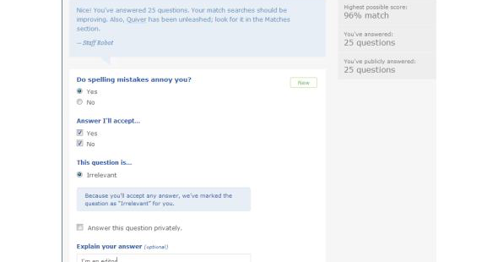



ANOTHER EXAMPLE:

Slide 5
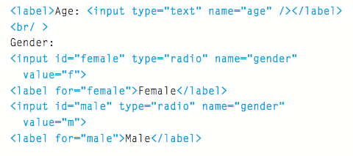

Please copy into your notebook~

Slide 6
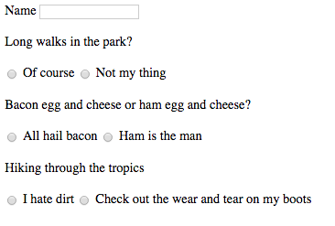
ACTIVITY
make a fake dating website form:

